Slide 1

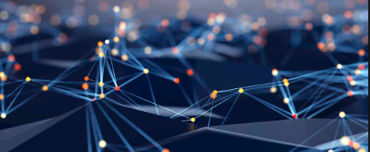
AI-DRIVEN KNOWEDGE GRAPH FOR HEALTHCARE INSIGHTS
AI 395T – AI IN HEATHCARE
ROSHNI VENKAT

Slide 2
Problem Statement
Significant portion of healthcare data is unstructured and complex
Most of the developer work with healthcare data involves preprocessing multiple files of tabular data and writing complex queries
This takes up lot of developer time and energy
There is also a significant computational cost to repeatedly create secondary data sources
Restructuring how data is aggregated, stored, and queried could rapidly boost performance

Slide 3
Solution
Use a knowledge graph to aggregate and store heathcare data
This allows data to be stored as a graph with “relationships” between them rather than in tabular form
Tabular data stored in multiple files are now well-structured as a graph database
We can uncover additional insights without having to process the data further
Utilize LangChain and OpenAI’s LLMs to query the database using natural language
Eliminates the need to write and test complex queries
Saves significant amount of developer time and effort
Allows anyone to query the database, from doctors to researchers
Create a Graph Data Science (GDS) graph to cluster patients
Uncovers new insights about patient conditions

Slide 4

Data
Synthetic COVID-19 data sourced from https://synthea.mitre.org/downloads
Link to dataset: COVID-19 10K, CSV
Tabular CSV files used in this project:
Patients.csv
Medications.csv
Encounters.csv
Conditions.csv
178 conditions and 321,528 encounters (visits)

Slide 5

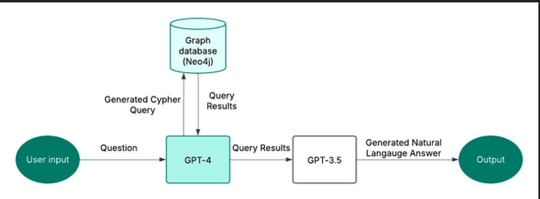



Architecture

Slide 6
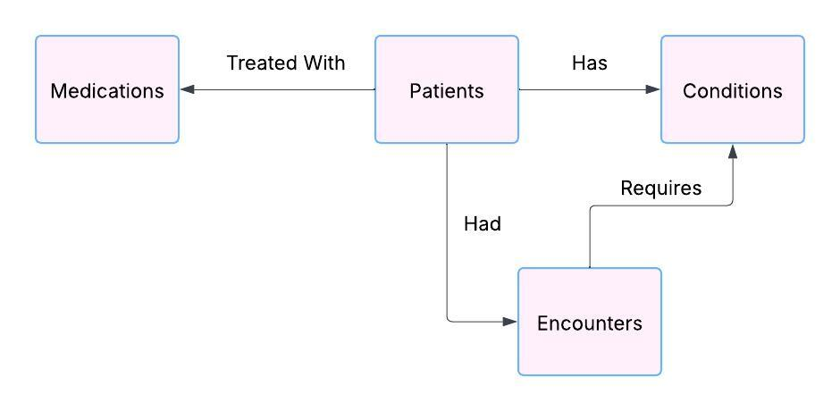
Build knowledge graph
Use Neo4j to create the knowledge graph
Each table (like patients, medications etc.) becomes an entity in the graph
Structured link between the tables is represented by arrows in the graph
Build original data schema in cloud service AuraDB
Save the cypher script
Run script against local instance
Data from CSV files imported into the graph

Slide 7
Generate queries and responses using LLMs
Create a cypher chain using GPT-4 and GPT-3.5
GPT-4
Generates Cypher query based on user input
Feeds query into the Neo 4j knowledge graph and retrieves query results
GPT-3.5
Processes query results
Converts the results to a natural language response as output

Slide 8
Cluster patients using Graph Data Science and analyze mortality rates
Create an undirected GDS graph of patients and conditions
Use the Louvain algorithm to create clusters (communities) of patients that have similar conditions
The detected community for each patient is stored with the property “community”
Compute the most prevalent conditions in each community and patients with the highest influence in spreading symptoms
Find the mortality rate of patients using the date of death (DOD) field in the patients table
The field is only populated if the patient died
Example of a case where the LLM cypher chain failed: it didn’t know which field to look for

Slide 9
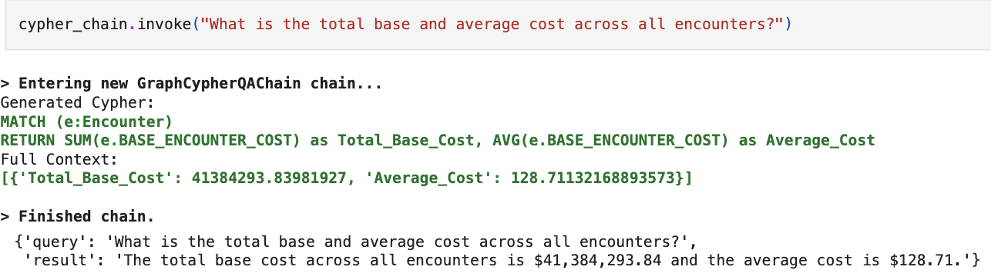
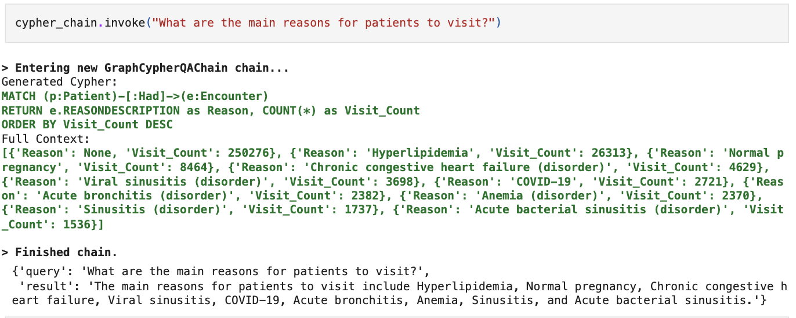
Results: AI-powered knowledge graph
Storing the data in the Neo4j knowledge graph rather than in the tabular form accelerated performance
Responses to natural language questions were generated by LLMs in milliseconds
Most questions were answered accurately by LLMs
After thorough testing, I found that the point of failure was the cypher query generation
If it didn’t understand the question correctly, it provided an incorrect query, leading to an unrelated response
The figures to the right show the entire process of cypher query generation, and how it retrieves data from thousands of datapoints stored in the graph simultaneously

Slide 10
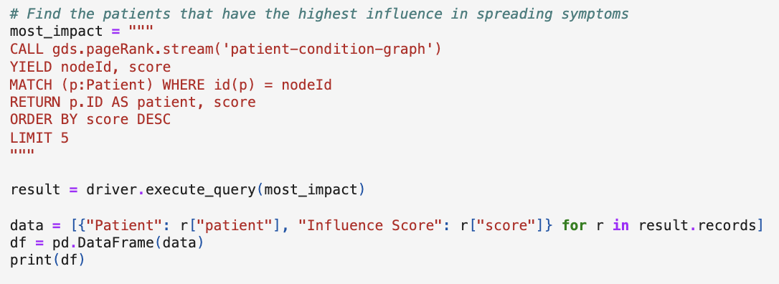
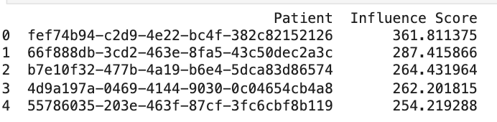
Results: Patient Clustering
Found 12,206 communities of patients with similar conditions
The largest community had 93 patients
The top 3 conditions prevalent in the largest community of patients were muscle pain, joint pain, and loss of taste
The figure on the right shows patients that are at the highest risk of spreading symptoms of COVID-19

Slide 11
Future Work
Improve process of Cypher query generation through more training and reinforcement learning
Expand domain knowledge integration by incorporating external datasets like clinical trials and drug interactions.
Train and test on additional data sources, including real-world healthcare data
Use the LLMs full potential by training on unstructured data like physician’s notes and patient reports
Expand Graph ML models for predicting patient visits, mortality, and next best actions
Develop explainable AI methods to improve interpretability and trust in model outputs

Slide 12
Thank you!

